Slide 1
Topic 5 Firewalls
ST251Y Ethical Hacking and Defences

Slide 2
Topic 5 : Firewalls
Understand Network Address Translation (NAT)
Understand the use of Proxy Servers
The Demilitarized Zone (DMZ), Bastion Hosts and Honeypots
Explain what firewalls can and cannot do
Describe common approaches to packet filtering
Establish a set of rules and restrictions for a firewall
Explore common firewall configurations
Compare hardware and software firewalls

Slide 3
Network Address Translation (NAT)
A network device (usually a firewall or proxy server) hides internal IP addresses from the outside world
A public IP address is presented to the outside world
Internal PC 192.168.2.4
Internal PC 192.168.2.5
Firewall with NAT
Internal IP : 192.168.2.100
External IP : 164.78.5.69
Internal PC 192.168.2.6
The internal IPs 192.168.2.n are hidden from the outside world
Only the public IP 164.78.5.69 is seen by outside networks

Slide 4
Why NAT?
Reduces the number of public IP addresses required by an organisation
Hundreds or even thousands of internal computers can be behind a single public IP address
Internal IP addresses are hidden from outside attackers

Slide 5


How does NAT work?
When an internal computer wants to request a web page from a web server on the Internet, its packets goes to the NAT device first
Internal IP 10.0.20.11
External IP 211.24.120.5
NAT device
Web Server 68.29.12.56
Computer A
10.0.20.28
Computer A sends a packet
Source IP : 10.0.20.28
Dest IP : 68.29.12.56

Slide 6
How does NAT work?
The NAT device will replace the source IP with its public IP address and sends the packet to the web server on the Internet
Internal IP 10.0.20.11
External IP 211.24.120.5
NAT device
Web Server 68.29.12.56
Computer A
10.0.20.28
NAT Device sends the packet to Web Server
Source IP : 211.24.120.5
Dest IP : 68.29.12.56

Slide 7
How does NAT work?
The web server only sees the public IP address. It will send its packets to the NAT device
Internal IP 10.0.20.11
External IP 211.24.120.5
NAT device
Web Server 68.29.12.56
Computer A
10.0.20.28
Web Server responds with a packet for NAT device
Source IP : 68.29.12.56
Dest IP : 211.24.120.5

Slide 8
How does NAT work?
The NAT device will remember which internal computer requested for the web page and sends the packet accordingly
Internal IP 10.0.20.11
External IP 211.24.120.5
NAT device
Web Server 68.29.12.56
Computer A
10.0.20.28
NAT Device forwards packet to Computer A
Source IP : 68.29.12.56
Dest IP : 10.0.20.28

Slide 9
Proxy Server
A proxy server intercepts internal user requests and processes that request on behalf of the user
2. Proxy Server connects to Web Server to request for web page
1. User requests for web page
Proxy Server
Web Server
4. Proxy Server forwards web page to user
3. Web Server returns web page to Proxy Server

Slide 10
Proxy Server
The Proxy Server keeps a cache of the retrieved web pages
Other users requesting for the same pages can retrieve them from the Proxy Server cache
Faster retrieval time
Proxy Servers can filter web content
Block access to undesirable websites
Keeps log of websites accessed by users

Slide 11
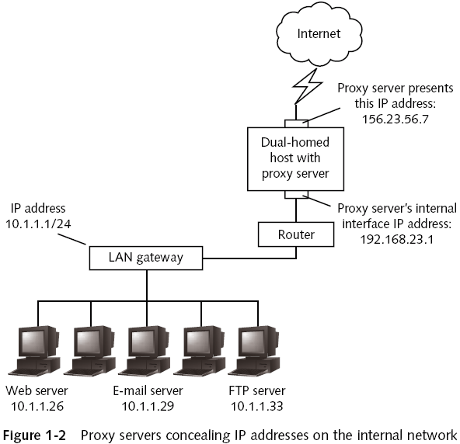
Proxy Server
Proxy servers can also be used to hide IP addresses

Slide 12
How Proxy Servers work
Proxy servers prevent direct connections between external computers and internal computers
Proxy servers work at the application layer
Examines the data in the packet
Decides to which application or system to forward the packet to
Reconstructs the packet and forwards it
Replace the original header with a new header containing proxy’s own IP address

Slide 13
User
IP : 192.168.7.14
User sends packet requesting for web page
Src IP : 192.168.7.14
Dest IP : 89.19.30.6
1. User requests for web page
Internal IP : 192.168.7.1
External IP : 209.18.7.48
2. Proxy Server connects to Web Server to request for web page on behalf of the user
Proxy Server
Proxy Server sends packet requesting for web page
Src IP : 209.18.7.48
Dest IP : 89.19.30.6
Web Server
IP : 89.19.30.6

Slide 14
User
IP : 192.168.7.14
4. Proxy Server forwards web page to user
Proxy Server forwards packet containing web page to User
Src IP : 89.19.30.6
Dest IP : 192.168.7.14
Internal IP : 192.168.7.1
External IP : 209.18.7.48
3. Web Server returns web page to Proxy Server
Proxy Server
Wed Server returns packet containing web page
Src IP : 89.19.30.6
Dest IP : 209.18.7.48
Web Server
IP : 89.19.30.6

Slide 15
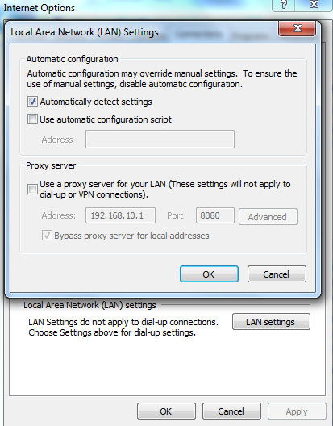
Connecting to Proxy Servers
Client programs (eg web browsers) can be configured to connect to the proxy server instead of the Internet
Transparent proxy servers (or intercepting proxies) do not require the client to be specially configured

Slide 17
Choosing a Proxy Server
Freeware proxy servers
Often described as content filters
May not have advanced features
Example: Squid
Commercial proxy servers
Offer Web page caching, source and destination IP addresses translation, content filtering, and NAT
Example: Many hardware firewalls come with proxy server functionality

Slide 18

Reverse Proxy
A reverse proxy is used to help the web server
Can offload some of the load on the web server by caching static web content
Can perform load balancing among multiple web servers
Can handle the SSL encryption, freeing the web servers from doing the encryption/decryption of data
Clients
Web Server 1
Reverse Proxy
Web Server 2

Slide 20
DMZ
Normally all internal computers are kept inaccessible from the Internet
But public users will need to access some resources like Web Servers
The DMZ (Demilitarized zone) is a section of the network that is visible to the outside world
Public users can access the DMZ but cannot enter the internal secured network
May also be called service network or perimeter network

Slide 21
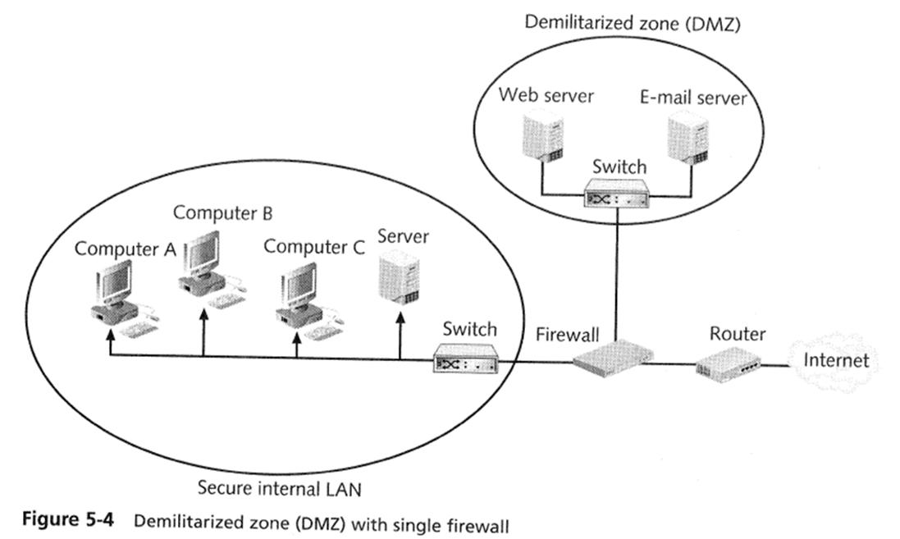

Slide 22
Bastion Host
Normally refers to a computer that has been specially protected through OS patches, authentication, encryption, etc
Such specially secured computers are normally those at the network perimeter (may be in the DMZ)
Usually provides Web, FTP, e-mail, or other services running on a specially secured server

Slide 24

Honeypot
Computer placed on the network perimeter
Attracts attackers away from real and critical servers
Another goal of a honeypot is logging
Logs are used to learn about attackers’ techniques
Legal issues
Example : what if the attacker uses your purposely unsecured honeypot to harm other networks?

Slide 26

Overview of firewalls
Firewall
Hardware or software
To block unauthorized network access
Earliest firewalls were packet filters
Firewall
Packet
Packet accepted
Packet blocked

Slide 27
Firewall rules
Firewalls can be configured by setting rules
Rules for blocking traffic may be done case-by-case
Actions include:
Allow the traffic
Block the traffic
Customize access (eg forward packet to another set of rules for further processing)

Slide 29
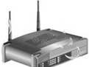

What firewalls can’t do
Firewalls cannot protect connections that do not go through it
Firewall
Employee sets up illegal access point that is not secured
Hacker accesses network through illegal access point, bypassing firewall

Slide 30
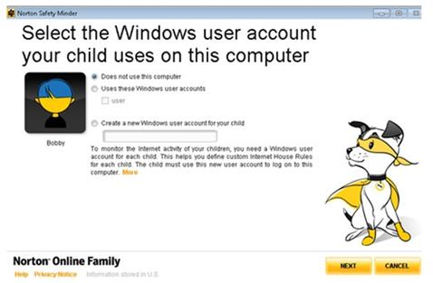
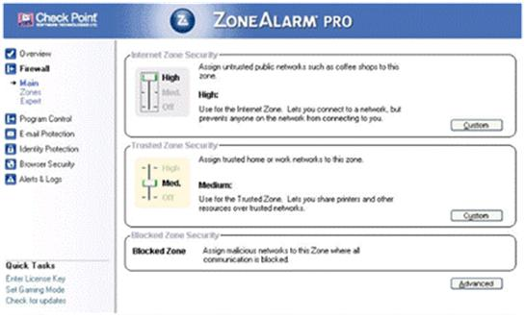
Personal Firewalls
Some firewalls are designed for personal use
Norton Internet Security
ZoneAlarm

Slide 31
Enterprise Firewalls
Some firewalls are designed for company/enterprise use
For monitoring and protecting large-scale networks
Manage security policies throughout the organisation

Slide 32
Firewalls only a part of security solution
Firewalls are not a standalone solution
Cannot protect from internal threats
Need strong security policy and employee education
Firewalls must be combined with other security solutions
Antivirus software
Intrusion Detection Systems

Slide 33
Packet Filtering
Only info in packet headers are checked
Data in packets not checked
Stateless packet filtering
Stateful packet filtering

Slide 34
Stateless Packet Filtering
Decides whether to allow or block packets based only on information in the protocol headers
Filtering based on common IP header features
IP address and Ports
Protocols
Flags and options
Advantage: Inexpensive and fast
Disadvantage: Attacks nowadays are more complicated

Slide 36
Stateful Packet Filtering
Besides looking at information in the protocol headers, keeps a record of connections the host computer has made with other computers
Maintain a file called a state table containing a record of all current connections
Allows incoming packets to pass through only from external hosts already connected

Slide 37
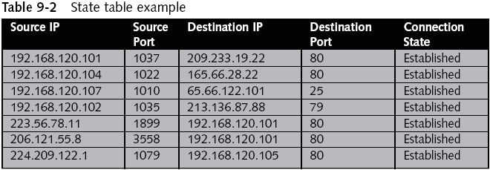

Slide 38
Typical locations of Packet Filters
Packet filter placement
Between the Internet and a host/network
Between a proxy server and the Internet
At either end of a DMZ

Slide 40
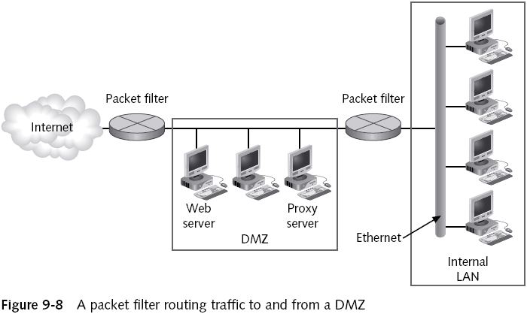

Slide 41
Application Layer Firewall
Inspects both header and data portions of packets
Also known as content filtering
Application Layer Firewalls can check for malicious code contains in the packet data
Combination of packet filters and application layer firewalls can be used in a network

Slide 42
Configuring Firewall rules
Rule base
Tells firewalls what to do when a certain kind of traffic attempts to pass
Points to consider
Based on organization’s security policy
Determine what can be accessed from external network
Logging and auditing requirements
Network Address Translation (NAT), if used
Simple and short as possible – firewall should not cause too much delay in network speed, and should be easy to maintain

Slide 43
Base Firewall Rules on Security Policy
Examples of common security policies to be reflected in the firewall rules (different companies will have different security policies)
Employees have access to Internet with restrictions
Public can access company’s Web and e-mail server
Only authenticated traffic can access the internal LAN
Employees are not allowed to use instant-messaging
Traffic from the company’s ISP should be allowed
Block external traffic by instant-messaging software
Only network administrator should be able to access internal network directly from the Internet

Slide 44
Keep the rule base simple
Keep list of rules as short as possible
So firewall will perform faster
Firewalls process rules in a particular order
If the rules are numbered, the firewall will match packets with the first rule, then the second rule, and so on
Most important and frequently-accessed rules should be at the top of the list
Make the last rule a cleanup rule
A catch-all type of rule

Slide 45
Firewall Rules
Incoming
 | Source IP | Source Port | Dest IP | Dest Port | Action
1 | Any | Any | 192.168.1.10 | 80 | Allow
2 | 192.168.3.0/24 | Any | 192.168.1.24 | 22 | Allow
3 | 192.168.3.10 | Any | 192.168.1.24 | 22 | Deny
4 | Any | Any | Any | Any | Deny
Rule 3 will never be activated, because Rule 2, which is processed first, will allow the packets
Rule 3 should be placed before Rule 2
Rule 4 is the cleanup rule – deny all other traffic

Slide 47
Restrict Subnets, Ports, and Protocols
You can filter by
IP addresses
Ports
Some firewalls can filter by the name of a service (no need to remember port number)
Some firewalls can also filter by the six TCP control flags or by IP options

Slide 48
General Practices
Rules should follow a few general practices
Most frequently matched rules should be near the top of the rule base for faster processing
Nobody can connect to the firewall except the administrator
Block direct access from the Internet to any computer behind the firewall
Permit access to public services in the DMZ

Slide 49
Firewall IP : 192.168.120.1
Subnet of Company

Slide 50
Mail Server IP : 192.168.120.2
Web Server IP : 192.168.120.3
With Rule 3, do we need Rules 4 and 6?

Slide 51




Anti-Spoofing Rule
In many firewall configurations, the first rule is the Anti-Spoofing rule.
The anti-spoofing rule blocks packets coming from outside network pretending to be an internal system
Hacker pretending
to be Computer 1
Computer 1
192.168.1.10
Packet
Source : 192.168.1.10
Destination : 192.168.1.20
Firewall drops packet because packets from Computer 1 should not be coming in from outside
Computer 2
192.168.1.20

Slide 52
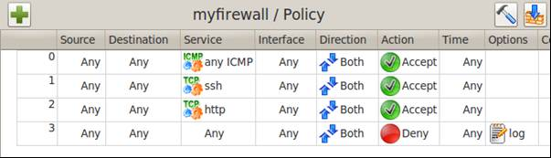
Firewall Rule Matching
Firewalls match packets to rules in a particular order
Once a rule is matched, the packet is processed according to the action specified in the rule (usually to allow or block the packet)
For firewalls with numbered rules, the packets are matched to rules according to the Rule Numbers.
Rule Numbers

Slide 53

Firewall Rule Matching
Other firewalls will match the Deny rules first, then match the Allow rules
Packets that do not match any rules will follow the firewall’s default policy action (normally set to Deny any packet that is not explicitly allowed)
The Block rule will take precedence and be matched to ICMP packets first.

Slide 54
Firewall Logs
Decide what to log
Some firewalls log only packets associated with a Deny rule (eg blocked IP addresses)
Configuring the log file format
Many firewalls generate log files in plain text
Sophisticated firewalls save log files in other formats
Review log files regularly
Log files can indicate signatures of attack attempts

Slide 55
Firewall Logs
Preparing log file summaries and generating reports
Log summary
Shows major events over a period of time
Contain raw data that can be used to create reports
Some firewalls contain log file analysis tools
Viewing raw data can be tedious and prone to errors
Reports
Display data in an easy-to-read format

Slide 56
Designing Firewall Configurations
Firewalls can be deployed in several ways
As part of a screening router
Dual-homed host
Screen host
Screened subnet DMZ
Multiple DMZs
Multiple firewalls
Reverse firewall
There can be other methods of deploying firewalls
Depends on the company’s network and needs

Slide 57
Screening Router
Screening router
Determines whether to allow or deny packets based on their source and destination IP addresses
Or other information in their headers
Does not stop many attacks
Especially those that use spoofed or manipulated IP address information
Should be combined with a firewall or proxy server
For additional protection

Slide 59
Dual-Homed Host
Dual-homed host
Computer that has been configured with more than one network interface
Firewall software forwards packets from one network interface to another
Provides limited security
Host serves as a single point of entry to the organization

Slide 61
Screened Host
Screened host
Similar to a dual-homed host
Can add router between the host and the Internet
To carry out IP packet filtering
Combines a dual-homed host and a screening router
Can function as a gateway or proxy server

Slide 62
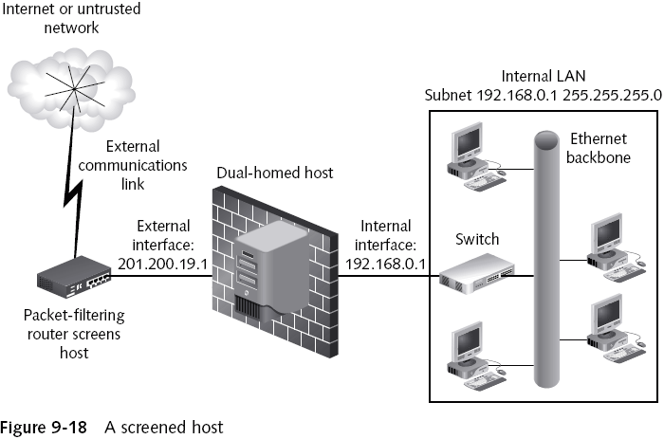

Slide 63
Screened Subnet DMZ
DMZ
Subnet of publicly accessible servers placed outside the internal LAN
Called a “service network” or “perimeter network”
Firewall that protects the DMZ is connected to the Internet and the LAN
Called a three-pronged firewall

Slide 64
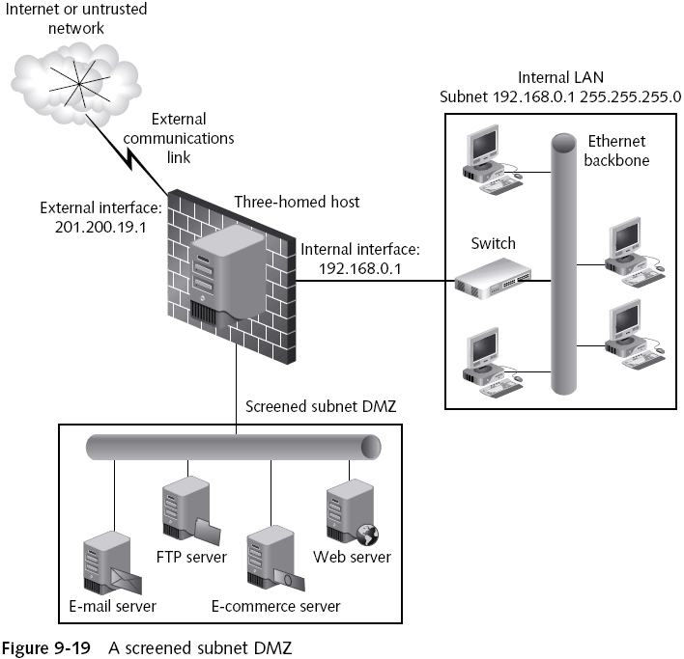

Slide 65
Multiple DMZ/Firewall Configurations
Server farm
Group of servers connected in their own subnet
Work together to receive requests with the help of load-balancing software
Load-balancing software
Prioritizes and schedules requests and distributes them to servers
Clusters of servers in DMZs help protecting the network from becoming overloaded
Each server farm/DMZ can be protected with its own firewall or packet filter

Slide 67
Multiple Firewall Configurations
Protecting a DMZ with two or more firewalls
One firewall controls traffic between DMZ and Internet
Second firewall controls traffic between protected LAN and DMZ
Can also serve as a failover firewall
Advantage
Can control where traffic goes in the three networks you are dealing with

Slide 68
Multiple Firewall Configurations (continued)
Additional firewall placed inside internal network to protect network management systems
Extra level of protection for network management systems
Intruders that gain control of network management system can potentially gain access to all network

Slide 70
Multiple Firewall Configurations (continued)
Protecting branch offices with multiple firewalls
Multiple firewalls can implement a single security policy
Central office has a centralized firewall
Directs traffic for branch offices and their firewalls
Deploys security policy through this firewall using a security workstation

Slide 71
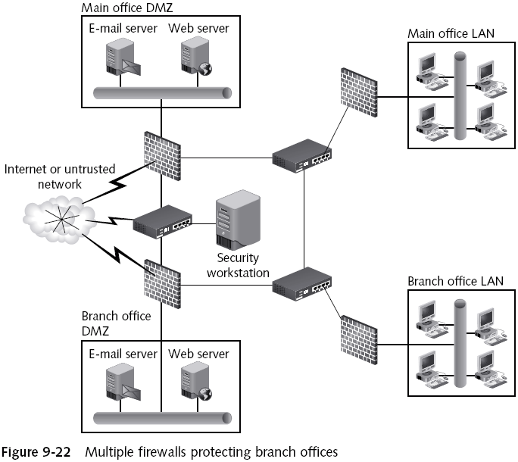

Slide 72
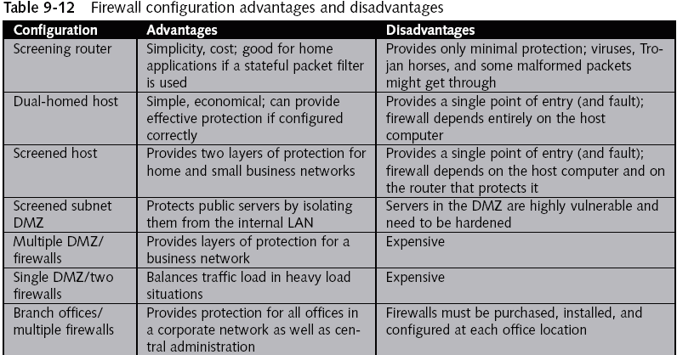

Slide 73
Comparing Software and Hardware Firewalls
Software-based firewalls
Hardware-based firewalls
Hybrid firewalls

Slide 74
Software-Based Firewalls
Free firewall programs
Commercial firewall programs for personal use
Commercial firewall programs for enterprise use
Capable of managing multiple instances from a centralized location

Slide 75
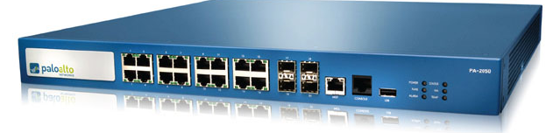
Hardware Firewalls
Also called firewall appliances
Advantages
Do not depend on conventional OSs
Generally more scalable than software firewalls
Disadvantages
They do depend on nonconventional OSs
Tend to be more expensive than software products

Slide 76
Hybrid Firewalls
Hybrid firewall
Combines aspects of hardware and software firewalls
Benefits from the strengths of both solutions

Slide 78
Summary
Understand Network Address Translation (NAT)
Understand the use of Proxy Servers
The Demilitarized Zone (DMZ), Bastion Hosts and Honeypots
Explain what firewalls can and cannot do
Describe common approaches to packet filtering
Establish a set of rules and restrictions for a firewall
Explore common firewall configurations
Compare hardware and software firewalls

